Slide 1
Predicting Graduate Employability Using Supervised Learning Methods

Slide 2
Defining the Problem
Given data on student performance, can I predict if a student will be employed after graduation?

Slide 3
The Dataset
Graduate Employability Dataset on Kaggle
URL: https://www.kaggle.com/datasets/sidraaazam/graduate-employability-dataset

Slide 4
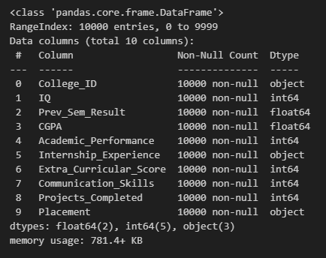
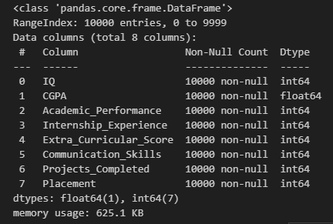
Notes on the EDA
Started with
Steps taken:
Load the data
Initial Visualization:
df.head()
df.info()
df.describe()
Determine the unique items in each column
Drop ID column
Map 1s and 0s in place of ‘Yes’s and ‘No’s
Ended with

Slide 5
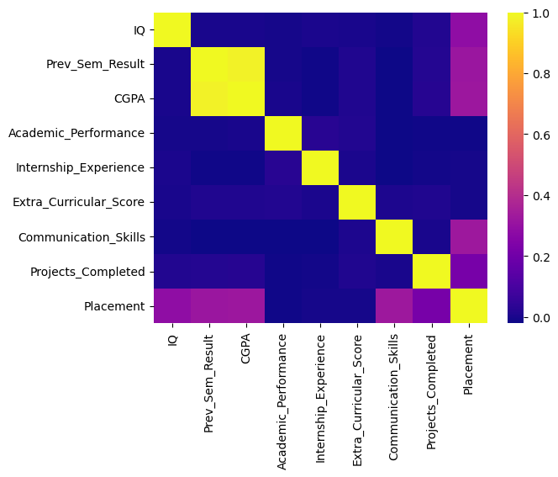
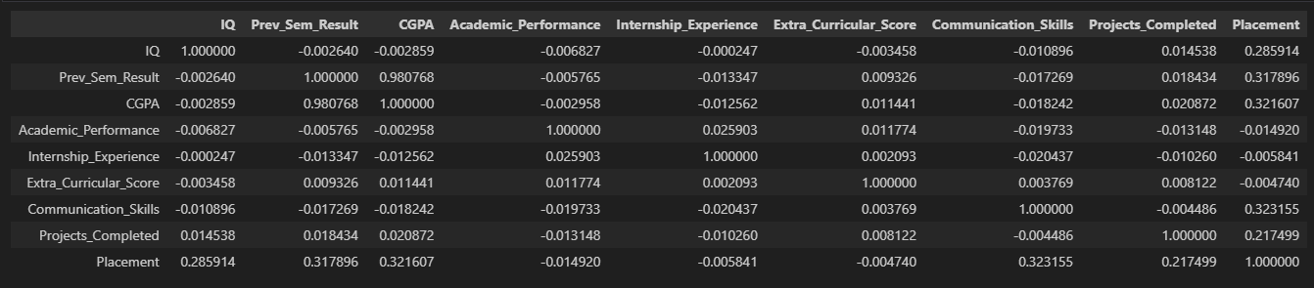
More on the EDA
Looking at the correlation matrix and its corresponding heatmap, I was able to drop the Prev_sem_result column, that housed the students’ previous semester’s GPA score, as it had a strong correlation with Cumulative GPA.

Slide 6
Various ML Approaches Used
Multiple Linear Regression
Logistic Regression
Non-parametric model:
K-Nearest Neighbors
Ensembles
RandomForest
Adaboost
SVM
LinearSVC

Slide 7
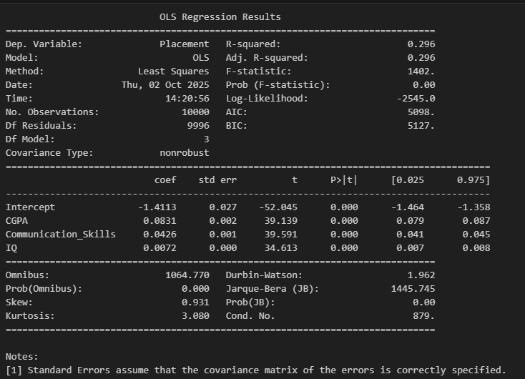
Multiple Linear Regression
Three chosen predictors:
CGPA
Communication Skills
IQ
R-squared = 29.6%
F-statistic shows model is statistically significant as a whole
Low R-squared may indicate that linearity may not be the best fit for the data

Slide 8
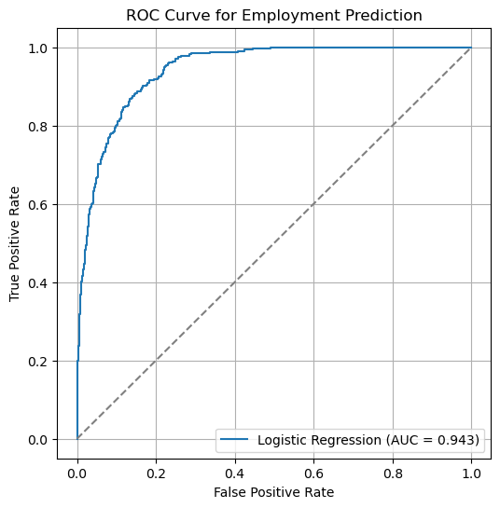
Logistic Regression
AUC = 0.943
This indicates that my model has a very strongly discriminative ability for this data
The shape of this curve shows that, at most thresholds, the model is able to correctly classify the students

Slide 9
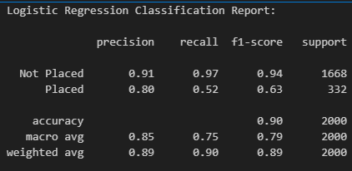
Logistic Regression

Slide 10
Non-parametric Model

Slide 11
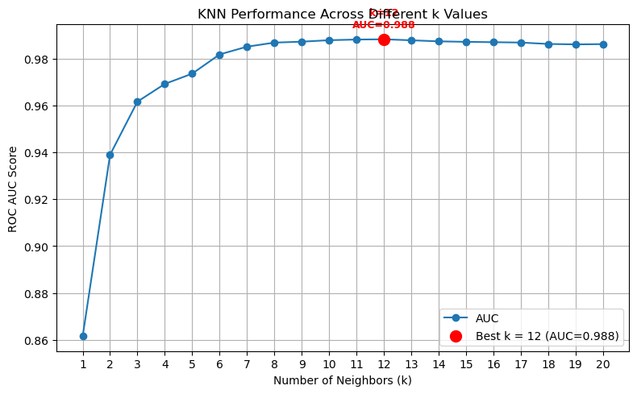
K-Nearest Neighbors
Determined best k
Will use k=12

Slide 12
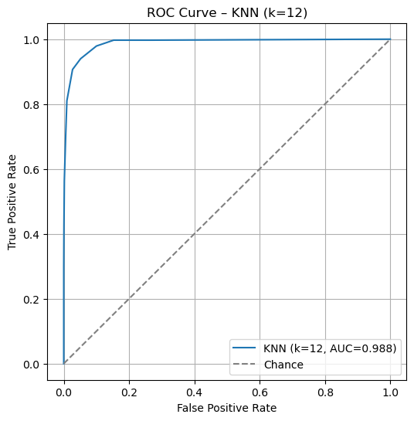
K-Nearest Neighbors
AUC = 0.988
This indicates that my model has an incredibly strongly discriminative ability for this data
The shape of this curve shows that, at most thresholds, the model is able to correctly classify the students

Slide 13
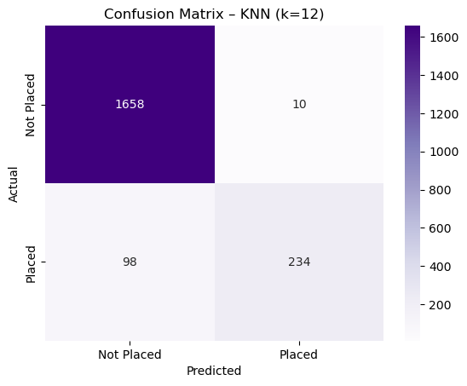
K-Nearest Neighbors
Very simple confusion matrix, shown at right as a heatmap
98 false negatives
10 false positives
1658 true negatives
234 true positives

Slide 14
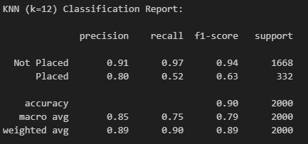
KNN (k=12)

Slide 15
Ensembles

Slide 16
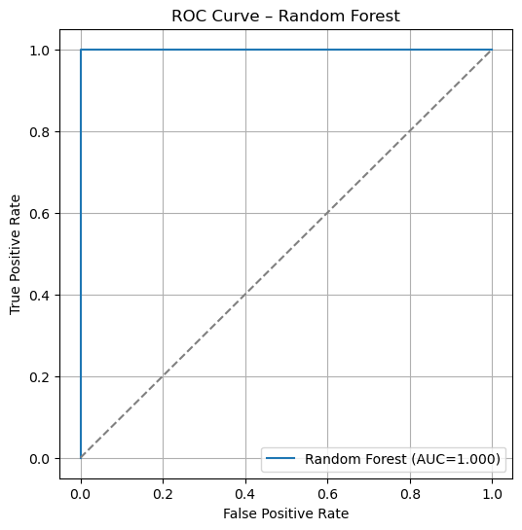
RandomForest Classifier
AUC = 1.0
This is a strong indication of overfitting.
The model may be too complex for the data.

Slide 17
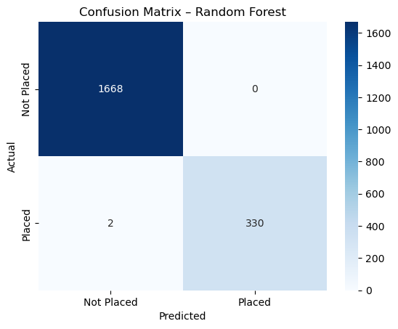
RandomForest Classifier
Very simple confusion matrix, shown at right as a heatmap
2 false negatives
0 false positives
1668 true negatives
330 true positives

Slide 18
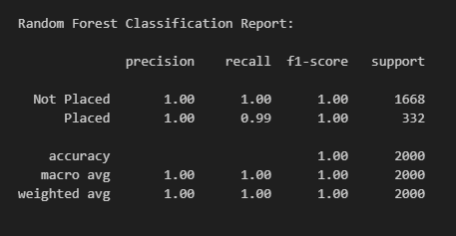
RandomForest Classifier

Slide 19
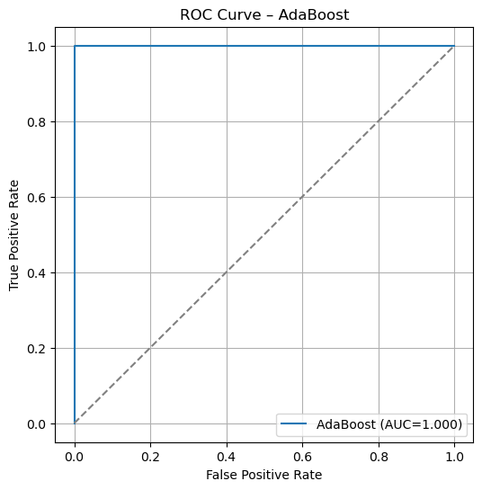
AdaBoost Classifier
AUC = 1.0
This is a strong indication of overfitting.
The model may be too complex for the data.

Slide 20
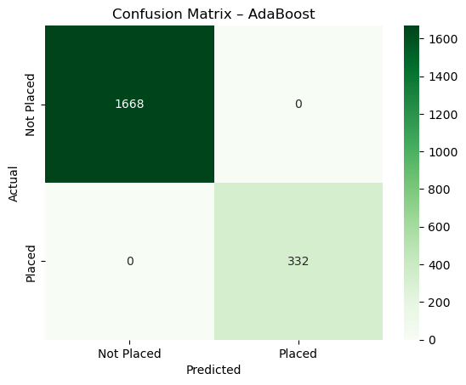
AdaBoost Classifier
Very simple confusion matrix, shown at right as a heatmap
0 false negatives
0 false positives
1668 true negatives
332 true positives

Slide 21
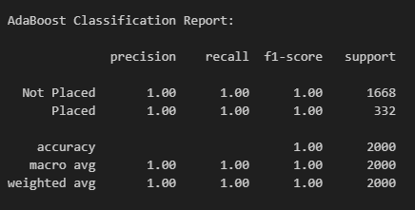
AdaBoost Classifier

Slide 22
SVM: Support Vector Machines

Slide 23
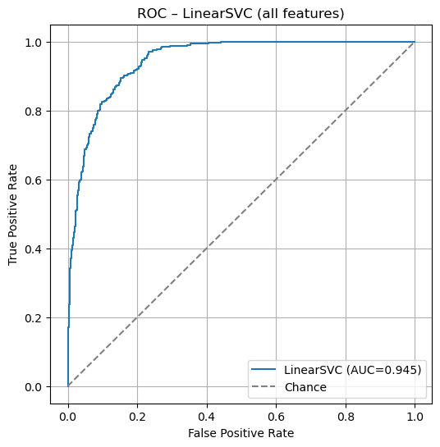
LinearSVC
AUC = 0.945
This indicates that my model has a very strongly discriminative ability for this data
The shape of this curve shows that, at most thresholds, the model is able to correctly classify the students

Slide 24
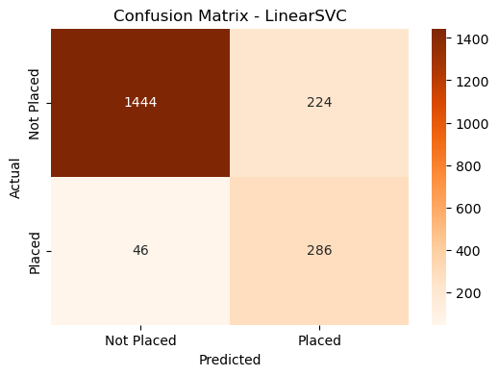
LinearSVC
Very simple confusion matrix, shown at right as a heatmap
46 false negatives
224 false positives
1444 true negatives
286 true positives

Slide 25
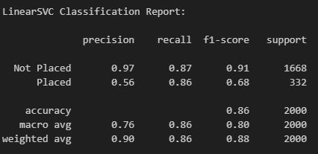
LinearSVC

Slide 26
Comparison of Model Performance
Model | AUC | Accuracy | Remarks
Multiple Linear Regression |  | R^2 = 0.296 | Too simple.
Logistic Regression | 0.943 | 0.90 | Good fit
KNN (k=12) | 0.988 | 0.90 | Good fit
RandomForest Classifier | 1.00 | 1.00 | Appears to be overfit
AdaBoost Classifier | 1.00 | 1.00 | Appears overfit
Linear SVC | 0.945 | 0.86 | Fair number of false positives.

Slide 27
And the winner is:
Best performing model: Logistic Regression!
Although it has similar AUC and Accuracy to KNN, it is the simpler model.
Occam’s razor. The simplest way is often the best.

Slide 28
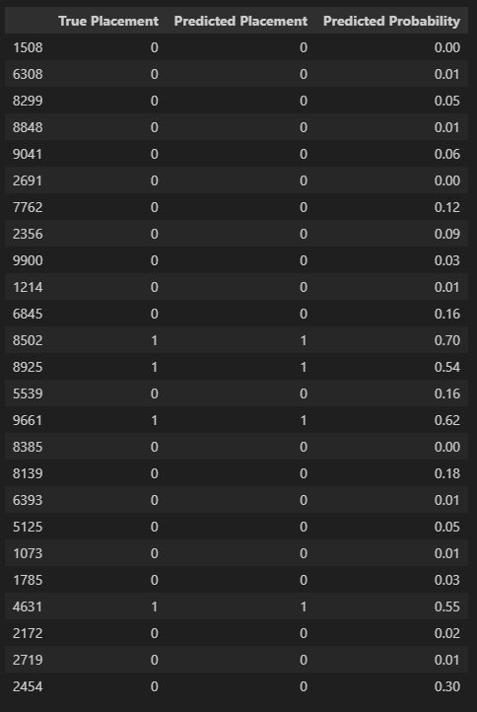
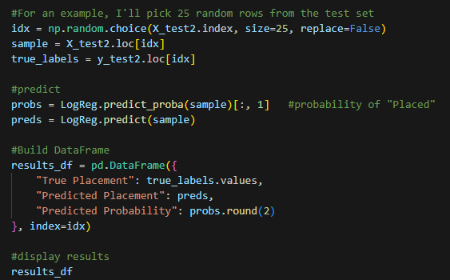
Example using Winning Model

Slide 29
Conclusion
Graduate Employability can best be predicted using Logistic Regression on this dataset.
A large number of other models will also work, though the ensemble methods, in particular, exhibited signs of overfitting.

Slide 30
That’s all folks!
Github Repo URL: https://github.com/Kate-Zilla/Graduate-Employability
Kaggle Dataset: https://www.kaggle.com/datasets/sidraaazam/graduate-employability-dataset

